Slide 1
Previous class Review
We have learnt about
Constants
Variable Names
Declarations
Data Types and Sizes
Arithmetic Operators
Relational and Logical Operators
Type conversions
Increment and Decrement Operators
Bitwise Operators
Assignment Operators and Conditional Expressions
Precedence and Order of Evaluation

Slide 2
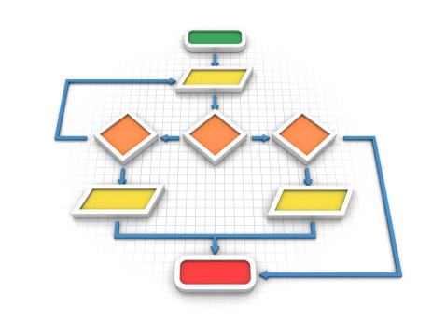
Decision Making, Branching & Switch

Slide 3
Objectives
To learn and appreciate the following concepts
The if Statement
The if-else Statement
Nested if Statements
The else if Ladder
The switch Statement

Slide 4
Outcome
At the end of session student will be able to learn and understand
The if Statement
The if-else Statement
Nested if Statements
The else if Ladder
The switch Statement

Slide 5
Control Structures
A control structure refers to the order of executing the program statements.
The following three approaches can be chosen depending on the problem statement:
Sequential (Serial)
In a Sequential approach, all the statements are executed in the same order as it is written.
Selectional (Decision Making and Branching)
In a Selectional approach, based on some conditions, different set of statements are executed.
Iterational (Repetition)
In an Iterational approach certain statements are executed repeatedly.
Notes:
Control structures are used to alter the flow of execution of the program. Why do we need to alter the program flow ? The reason is “decision making“! In life, we may be given with a set of option like doing “Electronics” or “Computer science”. We do make a decision by analyzing certain conditions (like our personal interest, scope of job opportunities etc). With the decision we make, we alter the flow of our life’s direction. This is exactly what happens in a C++ program. We use control structures to make decisions and alter the direction of program flow in one or the other path(s) available.

Slide 6
DECISION MAKING AND BRANCHING
C decision making and branching statements are:
1. if statement
2. switch statement

Slide 7
Different forms of if statement
1. Simple if statement.
2. if…else statement.
3. Nested if…else statement.
4. else if ladder.

Slide 8
Simple if Statement
General form of the simplest if statement:
if (test Expression)
{
statement-block;
}
next_statement;
If expression is true (non-zero), executes statement.
It gives you the choice of executing statement or skipping it.

Slide 9
if Statement- explanation
(test Expression) is first evaluated.
If TRUE (non-zero), the ‘if’ statement block is executed.
If FALSE (zero) the next statement following the if statement block is executed.
So, during the execution, based on some condition, some code will not be executed (skipped).
For example: bonus = 0;
if (hours > 70)
bonus = 10000;
salary= salary + bonus;

Slide 10
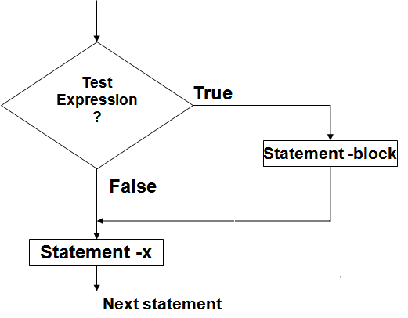
Flow chart of simple if
Entry

Slide 11
Find out whether a number is even or odd.
#include <stdio.h>
int main()
{
int x;
printf(“input an integer\n”);
scanf(“%d”,&x);
if ((x % 2) == 0)
{
printf(“It is an even number\n”);
}
if ((x%2) == 1)
{
printf(“It is an odd number\n”);
}
return 0;
}

Slide 12
The if-else statement
if (test expression )
{
statement _block1
}
else
{
statement _block2
}
Next_statement
if-else statement: enables you to choose between two statements

Slide 13
if-else statement
Explanation:
1.First ,the (test expression) is evaluated.
2.If it evaluates to non-zero (TRUE), statement_1 is executed, otherwise, if it evaluates to zero (FALSE), statement_2 is executed.
3.They are mutually exclusive, meaning, either statement_1 is executed or statement_2, but not both.
4.If the statements_ 1 and statements_ 2 take the form of block , they must be put in curly braces.
Example: if(job_code == 1)
rate = 7.00;
else
rate = 10.00;
prinf(“%d”,rate);

Slide 14
The if-else statement
Entry
expression
yes
no
Program statement 1
Program statement 2
Next _statement

Slide 15
Find out whether a number is even or odd.
#include <stdio.h>
int main() {
int x;
printf(“Input an integer\n”);
scanf(“%d”,&x);
if ((x % 2) == 0)
{
printf(“It is an even number\n”);
}
else
{
printf(“It is an odd number\n”);
}
return 0;
}

Slide 16
WAP to find largest of 2 numbers
#include<stdio.h>
int main()
{
int a, b;
printf(“Enter 2 numbers\n”);
scanf(“%d %d”,&a,&b);
a;
else
cout<<"large is "<<fb;
return 0;
}
if(a > b)
printf(“Large is %d\t“, a);
else
printf(“Large is %d\t“, b);

Slide 17
Attention on if-else syntax !
if ( expression )
program statement 1
else
program statement 2
In C, the ; is part (end) of a statement !
if ( remainder == 0 )
prinf("The number is even.\n“);
else
printf(“The number is odd.\n“);
Syntactically OK but a semantic error !
if ( x == 0 );
printf(“The number is zero.\n“);

Slide 18
Example: determine if a year is a leap year
#include<stdio.h>
int main()
{
int year;
printf(“Enter the year“);
scanf(“%d”,&year);
if(year%4 == 0)
{
if( year%100 == 0)
{
if ( year%400 == 0)
printf("%d is a leap year",year);
else
printf("%d is not a leap year",year);
} else printf("%d is a leap year",year);
} else printf("%d is not a leap year",year);
return 0;
}
A leap year is exactly divisible by 4 except for century years (years ending with 00). The century year is a leap year only if it is perfectly divisible by 400.
Notes:
A leap year is exactly divisible by 4 except for century years (years ending with 00). The century year is a leap year only if it is perfectly divisible by 400.

Slide 19
Testing for character ranges
Output:
enter a character:
C
uppercase char
special char
enter a character:
j
lowercase char
special char
enter a character:
5
digit char
#include<stdio.h>
int main()
{
char ch;
printf(“enter a character\n”);
scanf(“%c”,&ch);
if (ch >= 'a' && ch <= 'z')
printf(“lowercase char\n“);
if (ch >= ‘A' && ch <= ‘Z')
printf(“uppercase char\n“);
if (ch >= ‘0' && ch <= ‘9')
printf(“digit char\n“);
else
printf(“ special char\n”);
return 0;
}

Slide 20
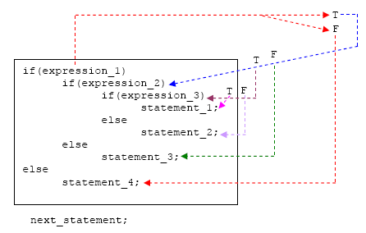
Nested if-else Statement

Slide 21
if-else nesting -Explanation
1. The if-else constructs can be nested (placed one within another) to any depth.
2. In this nested form, expression_1 is evaluated.
If it is zero (FALSE-F), statement_4 is executed and the entire nested if statement is terminated;
If not (TRUE-T), control goes to the second if (within the first if) and expression_2 is evaluated. If it is zero, statement_3 is executed;
If not, control goes to the third if (within the second if) and expression_3 is evaluated.
If it is zero, statement_2 is executed;
If not, statement_1 is executed. The statement_1 (inner most) will only be executed if all the if statement is true.

Slide 22
Smallest among three numbers
if (a < b)
{ if (a < c)
{ smallest = a; }
else
{ smallest = c; } }
else
{ if (b < c)
{ smallest = b; }
else
{ smallest = c; }
}
printf(“Smallest is %d“, smallest);
return 0;
}
#include <stdio.h>
int main()
{
int a, b, c, smallest;
printf(“Enter a, b & c\n“);
scanf(“%d %d %d, &a, &b, &c);

Slide 23
Nested if statements
if (number > 5)
if (number < 10)
printf(“1111\n“);
else printf(“2222\n“);
Rule: an else goes with the most recent if, unless braces indicate otherwise
if (number > 5) {
if (number < 10)
printf(“1111\n“);
}
else printf(“2222\n“);

Slide 24
The else-if ladder
if (Expression_1 )
{
statement _block_1
}
else if (Expression_2)
{
statement _block_2
}
…….
else if (Expression_n)
{
statement _block_n
}
else
{
last_statement
}
Next_statement

Slide 25
else-if ladder -Explanation
expression_1 is first evaluated. If it is TRUE, statement_1 is executed and the whole statement terminated and the next_statement is executed.
On the other hand, if expression_1 is FALSE, control passes to the else if part and expression_2 is evaluated.
If it is TRUE, statement_2 is executed and the whole system is terminated.
If it is False, other else if parts (if any) are tested in a similar way.
Finally, if expression_n is True, statement_n is executed; if not, last_statement is executed.
Note that only one of the statements will be executed others will be skipped.
The statement_n’s could also be a block of statement and must be put in curly braces.

Slide 26
else-if ladder Flow of control
True
False
Condition-1
True
False
statement-1
Condition-2
True
False
statement-2
Condition-3
True
False
statement-3
Condition-n
statement-n
default statement
next statement

Slide 27
Testing for character ranges
#include<stdio.h>
int main()
{
char ch;
printf(“enter a character\n”);
scanf(“%c”,&ch);
if (ch >= 'a' && ch <= 'z')
printf(“lowercase char\n“);
else if (ch >= ‘A' && ch <= ‘Z')
printf(“uppercase char\n“);
else if (ch >= ‘0' && ch <= ‘9')
printf(“digit char\n“);
else
printf(“ special char\n”);
return 0;
}

Slide 28
WAP using else-if ladder to calculate grade for the marks entered
int main() {
char cgrade;
int imarks;
printf("enter marks“);
scanf(“%d”,&imarks);
if(imarks>79)
cgrade = 'A';
else if (imarks>59)
cgrade = 'B';
else if (imarks>49)
cgrade = 'C';
else if (imarks>39)
cgrade = 'D';
else
cgrade = 'F';
printf(“Grade :%c\n”,cgrade);
return 0;
}
For inputs
imarks= 46
grade = D
imarks= 64
grade = B
if(imarks>79)
cgrade = 'A';
else if (imarks>59)
cgrade = 'B';
else if (imarks>49)
cgrade = 'C';
else if (imarks>39)
cgrade = 'D';
else
cgrade = 'F';

Slide 29
Example: else-if
// Program to implement the sign function
#include <stdio.h>
int main ( )
{
int number, sign;
printf("Please type in a number: “);
scanf(“%d”,&number);
if ( number < 0 )
sign = -1;
else if ( number == 0 )
sign = 0;
else // Must be positive
sign = 1;
printf(“Sign = %d“,sign);
return 0;
}

Slide 30
Example – multiple choices
/* Program to evaluate simple expressions of the form number operator number */
int main ( ) {
float value1, value2,result;
char operator;
printf("Type in your expression.\n“);
scanf(“%f %c %f”, &value1,&operator,&value2);
if ( operator == '+' ){
result=value1+value2;
printf(“%f”,result);
}
else if ( operator == '-' ) {
result=value1-value2;
printf(“%f”,result);
}
else if ( operator == '*' ) {
result=value1*value2;
printf(“%f”,result);
}
else if ( operator == '/' ) {
result=value1/value2;
printf(“%f”,result);
}
else
printf("Unknown operator.\n“);
return 0;
}

Slide 31
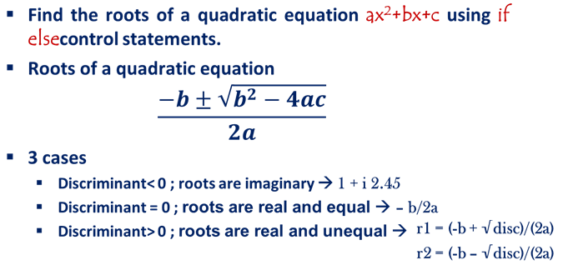
Problem…

Slide 32

Find the roots of Quadratic equation using if-else statement
#include<stdio.h>
int main()
{
float a,b,c,root1,root2,re,im, disc;
printf(" Enter the coefficients:");
scanf(“%f %f %f”,&a,&b,&c);
disc=b*b-4*a*c; // discriminant computation
if (disc<0) {
printf("imaginary roots\n“);
re= - b / (2*a);
im = pow(fabs(disc),0.5)/(2*a);
printf(“root1=%.2f+%.2fi and
root2 =%.2f-%.2fi”, re,im,re,im);
}
else if (disc==0)
{
printf(“Real & equal roots“);
re=-b / (2*a);
printf(“Root1 and root2 are %.2f”, re);
}
else /*disc > 0 */
{
printf(“Real & distinct roots“);
printf(“Roots are“);
root1=(-b + sqrt(disc))/(2*a);
root2=(-b - sqrt(disc))/(2*a);
printf(“Root1 = %.2f and root2
=%.2f”,root1,root2);
}
return 0;
}

Slide 33
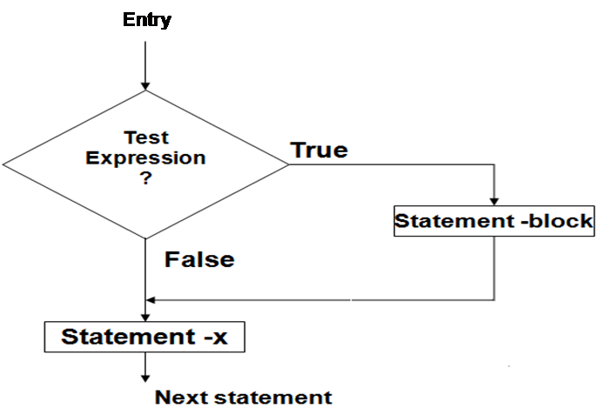
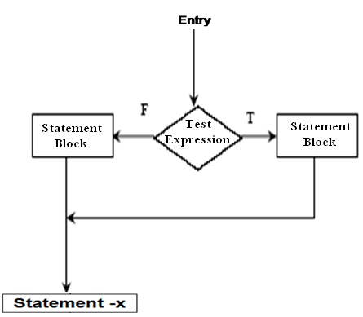
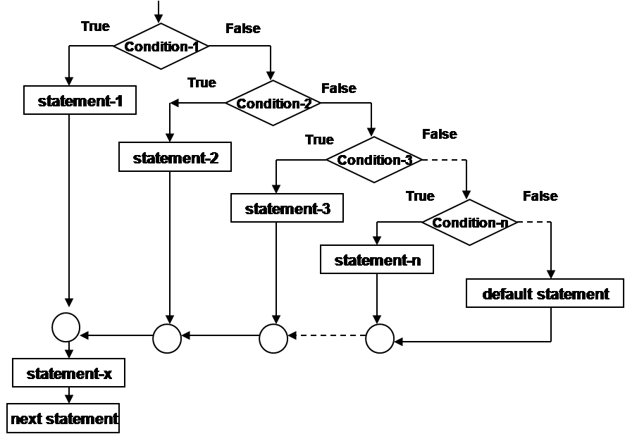
Review on decision making & branching
if
if-else
Nested if
else if Ladder

Slide 34
The switch Statement
Switch is multiple–branching statement where based on a condition, the control is transferred to one of the many possible points.
Enables the program to execute different statements based on an expression that can have more than two values. Also called multiple choice statements.

Slide 35
The switch statement
switch ( expression )
{
case value1:
program statement(s)
program statement(s)
break;
case value2:
program statement(s)
...
break;
case value n:
program statement(s)
program statement(s)
break;
default:
program statement(s)
program statement(s)
}
The expression is successively compared against the values value1, value2, ..., valuen.
If a case is found whose value is equal to the value of expression, the program statements that follow the case are executed.
The switch test expression must be one with an integer value (including type char) (No float !).
The case values must be integer-type constants or integer constant expressions (You can't use a variable for a case label !)

Slide 36
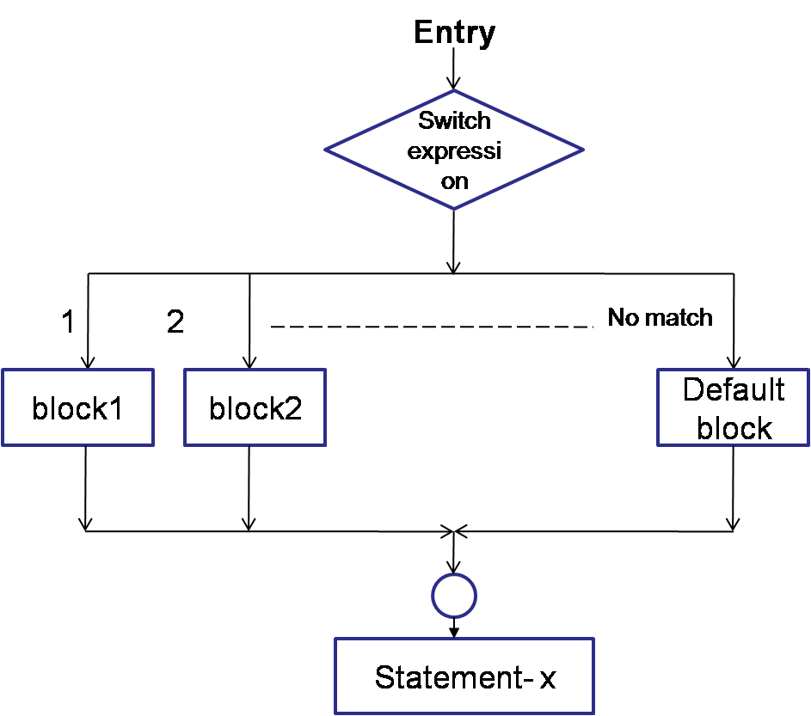
switch- control flow
Notes:
Evaluates the (expression) and compares its integer or character value
with the values following each case label.
1. If a match is found between (expression) and one of the values, execution is transferred to the statement(s) that follows the case label.
2. If no match is found, execution is transferred to the statement(s) following the optional default label.
3. If no match is found and there is no default label, execution passes to the first statement following the switch statement closing brace, the next_statement.
4. To ensure that only the statements associated with the matching template are executed, include a break statement where needed, which terminates the entire switch statement.
5. As usual the statement(s) can also be a block of code put in curly braces.

Slide 37
switch- example 1
#include<stdio.h>
int main()
{
int choice;
printf(“Enter your choice: 1-yes, 2-no\n”);
scanf(“%d”,&choice);
switch(choice)
{
case 1: printf(“YESSSSSSS……”);
break;
case 2: printf(“NOOOOOO……”);
break;
default: printf(“DEFAULT CASE…….”);
} printf(“The choice is %d”,choice);
return 0;
}
Notes:
Evaluates the (expression) and compares its integer or character value
with the values following each case label.
1. If a match is found between (expression) and one of the values, execution is transferred to the statement(s) that follows the case label.
2. If no match is found, execution is transferred to the statement(s) following the optional default label.
3. If no match is found and there is no default label, execution passes to the first statement following the switch statement closing brace, the next_statement.
4. To ensure that only the statements associated with the matching template are executed, include a break statement where needed, which terminates the entire switch statement.
5. As usual the statement(s) can also be a block of code put in curly braces.

Slide 38
switch- example
scanf(“%d”,&mark);
switch (mark)
{
case 100:
case 90:
case 80: grade=‘A’;
break;
case 70:
case 60:
grade=‘B’;
break;
case 50:
grade=‘C’;
break;
case 40:
grade=‘D’;
break;
default: grade=‘F’;
break;
}
printf(“%c”, grade);

Slide 39
switch- example
char ch;
scanf(“%c”,&ch);
switch(ch)
{
case ‘a’ : printf(“Vowel”); break;
case ‘e’ : printf(“Vowel”); break;
case ‘i’ : printf(“Vowel”); break;
case ‘o’ : printf(“Vowel”); break;
case ‘u’ : printf(“Vowel”); break;
default: printf(“Not a Vowel”);
}

Slide 40
switch- example
char ch;
scanf(“%c”,&ch);
switch(ch) {
case ‘a’ :
case ‘e’ :
case ‘i’ :
case ‘o’ :
case ‘u’ : printf(“Vowel”); break;
default: printf(“Not a Vowel”); }

Slide 41
Example - switch
/* Program to evaluate simple expressions of the form value operator value */
#include <stdio.h>
int main (void){
float value1, value2;
char operator;
int result;
printf("Type in your expression.\n“);
scanf(“%f %c %f”, &value1,&operator,&value2);
switch (operator) {
case '+':
result=value1+value2;
printf(“%f”,result);
break;
case '-': result=value1-value2;
printf(“%f”,result);
break;
case ‘*': result=value1*value2;
printf(“%f”,result);
break;
case ‘/': if ( value2 == 0 )
printf(“Division by zero.\n“);
else result=value1 / value2;
printf(“%f”,result);
break;
default:
printf(“Unknown Operator”);
}
return 0;
}

Slide 42
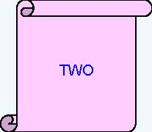
What is the output of the following code snippet?
int iNum = 2;
switch(iNum) {
case 1:
printf(“ONE”);
break;
case 2:
printf(“TWO”);
break;
case 3:
printf(“THREE”);
break;
default:
printf(“INVALID”);
break;
}

Slide 43
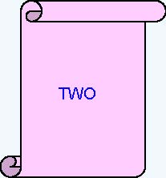
What is the output of the following code snippet?
iNum = 2;
switch(iNum) {
default:
printf(“INVALID”);
case 1:
printf(“ONE”);
case 2:
printf(“TWO”);
break;
case 3:
printf(“THREE”;)
}

Slide 44
What is the output of the following code snippet?
switch (iDepartmentCode)
{
case 110 : printf(“HRD ”);
case 115 : printf(“IVS ”);
case 125 : printf(“E&R ”);
case 135 : printf(“CCD ”);
}
Assume iDepartmentCode is 115
find the output ?
IVS E&R CCD

Slide 45
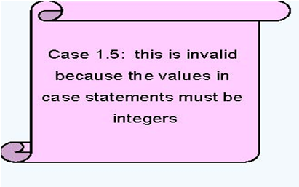
What is the output of the following code snippet?
int iNum = 2;
switch(iNum)
{
case 1.5:
printf(“ONE AND HALF”);
break;
case 2:
printf(“TWO”);
case ‘A’ :
printf(“A character”);
}

Slide 46
Problem: Find the roots of Quadratic equation using switch statement
#include<stdio.h>
int main()
{
Int d;
float a,b,c,root1,root2,re,im, disc;
printf(“Enter the values of a, b & c:“);
scanf(“%f %f %f”,&a,&b,&c);
disc=b*b-4*a*c;
printf("\nDiscriminant= %f“,disc);
if(disc<0) d=1;
if(disc==0) d=2;
if(disc>0) d=3;
switch(d) {
case 1:
printf("imaginary roots\n“);
re= - b / (2*a);
im = pow(fabs(disc),0.5)/(2*a);
printf(“root1=%.2f+%.2fi and root2 =%.2f-%.2fi”, re,im,re,im); break;

Slide 47
Problem: Find the roots of Quadratic equation using switch statement
case 2:
printf(“Real & equal roots“);
re=-b / (2*a);
printf(“Root1 and root2 are %.2f”,re);
break;
case 3: printf(“Real & distinct roots“);
printf(“Roots are“);
root1=(-b + sqrt(disc))/(2*a);
root2=(-b - sqrt(disc))/(2*a);
printf(“Root1 = %.2f and root2 =%.2f”,root1,root2); break;
} // end of switch
return 0;
} //End of Program

Slide 48
Some guidelines for writing switch case statements
Order the cases alphabetically or numerically – improves readability. Put the normal cases first ; put the exceptional cases later. Order cases by frequency:-put the most frequently executed cases first and the least frequently used cases later. Use default case to detect errors and unexpected cases [user friendly messages].

Slide 49
Flow of control in various control structures

Slide 50
Summary
The if Statement
The if-else Statement
Nested if Statements
The else if Ladder
The switch Statement

Slide 51
Review on decision making & branching control Structures
if
if-else
Nested if
else if Ladder
switch

Slide 52
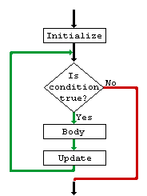
Loop Control Structures
L12-L13

Slide 53
Objectives
To learn and appreciate the following concepts
The for Statement
Nested for Loops
for Loop Variants
The while Statement
The do Statement
The break Statement
The continue Statement
Typedef and Enum

Slide 54
At the end of session student will be able to learn and understand
The for Statement
Nested for Loops
for Loop Variants
The while Statement
The do Statement
The break Statement
The continue Statement
Typedef and Enum

Slide 55
Controlling the program flow
Sequential
Forms of controlling the program flow:
Executing a sequence of statements (Sequential)
Using a test to decide between alternative sequences (branching)
Repeating a sequence of statements (until some condition is met) (looping)
Statement1
Statement2
Statement3
Statement4
Statement5
Statement6
Statement7
Statement8

Slide 56
Program Looping
A set of statements that executes repetitively for a number of times.
Simple example: displaying a message 100 times:
printf(hello !\n”);
printf(hello !\n”)
printf(hello !\n”)
…
printf(hello !\n”)
printf(hello !\n”)
Repeat 100 times
printf(hello !\n”)
Program loop: enables you to develop concise programs containing repetitive processes that could otherwise require many lines of code !

Slide 57
Iterative (loop) control structures
Each loop control structure will have
Program loop: body of loop.
control statement → tests certain conditions & then directs repeated execution of statements within the body of loop.
Two types: Based on position of control statement.
Entry controlled loop: control is tested before the start of the loop. If false, body will not be executed.
Exit controlled loop: test is performed at the end of the body. i.e. body of loop executed at least once.

Slide 58
Entry Controlled & Exit controlled loops
Entry
Entry
Test
Condition
False
Body of
The loop
True
Body of
The loop
Test
Condition
True
False

Slide 59
Iterative (loop) control structures
Three kinds of loop control structures:
while
do-while
for
Notes:
Iterative (repetitive) control structures are used to repeat certain statements for a specified number of times.
The statements are executed as long as the condition is true
These kind of control structures are also called as loop control structures

Slide 60
while statement
General form:
while (test expression)
{
body of the loop
}
Entry controlled loop statement.
Test condition is evaluated & if it is true, then body of the loop is executed.
This is repeated until the test condition becomes false, & control transferred out of the loop.
Body of loop is not executed if the condition is false at the very first attempt.
While loop can be nested.
Note: braces optional if only one statement.

Slide 61
The while statement
while ( expression )
{
program statement(s)
}
Loop with the test in the beginning !
Body might never be executed !
statement before loop
Loop_expression
3
1
No
4
yes
2
statement (s)
Next statement
Notes:
Explanation
Entry controlled loop statement
Loop_expression or Test condition is evaluated & if it is yes or true, then body of the loop is executed.
After execution, the Loop_expression or test condition is again evaluated & if it is yes or true, the body is executed again.
This is repeated until the Loop_expression or test condition becomes no or false, & control transferred out of the loop.
Body of loop is not executed if the condition is no or false at the very first attempt.

Slide 62
Finding sum of natural numbers up to 100
#include <stdio.h>
int main()
{
int n;
int sum;
sum=0; //initialize sum
n=1;
while (n < 100)
{
sum= sum + n;
n = n + 1;
}
printf(“%d”,sum);
return 0;
}
n=1;
while (n < 100)
{
sum= sum + n;
n = n + 1;
}

Slide 63
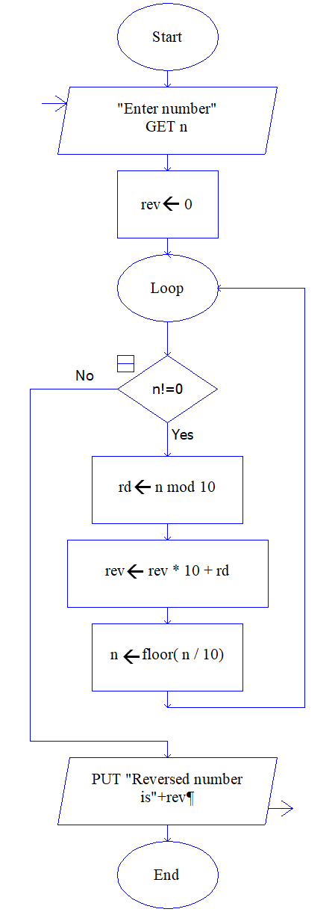
Program to reverse the digits of a number
Algorithm
Flowchart
Program
#include <stdio.h>
int main()
{
int n, rev=0, rd;
printf(“Enter your number.\n“);
scanf(“%d”,&n);
while ( n != 0 )
{
rd = n % 10;
rev=rev*10 + rd;
n = n / 10;
}
printf(“The reversed no is %d“, rev);
return 0;
}
Name of the algorithm: reverse the digits of a number n
Step 1: Start
step 2: Input n
Step 3: rev←0
Step 4: WHILE n!=0
begin
rd← n mod 10
rev← rev *10 + rd
n←n/10 (integer)
end
Step 5: Print ‘The reversed no is =‘, rev
Step 6: Stop

Slide 64
The do-while statement
General form:
do
{
body of the loop
}
while(test condition);
Exit controlled loop. At the end of the loop, the test condition is evaluated.
After do statement, program executes the body of the Loop.
Then, the condition is tested, if it is true, body of the loop is executed once again & this process continues as long as the condition is true.
Body of the loop is executed at least once.
do-while loop can be nested.

Slide 65
The do-while statement
do {
program statement (s) }
while ( loop_expression );
Loop with the test at the end !
Body is executed at least once !
3
1
Statement(s)
yes
loop_expression
2
No
Next statement
4
Notes:
Explanation
Exit controlled loop.
After do statement, program executes the body of the Loop.
At the end of the loop, the Loop_expression or test condition is evaluated.
If it is yes or true, body of the loop is executed once again & this process continues as long as the condition is true.
When condition becomes no or false, the loop will be terminated.
Body of the loop is executed at least once.
do … while loop can be nested.

Slide 66
Example: Finding sum of natural numbers up to 100
#include <stdio.h>
int main()
{
int n;
int sum=0;
n=1;
do
{
sum = sum + counter;
counter = counter +1;}}
} while (counter < 100);
printf(“%d”, sum);
return 0;
}
#include <stdio.h>
int main()
{
int n;
int sum =0;
n=1;
while (n<=100)
{
sum=sum+n;
n = n +1;
}
printf(“%d”, sum);
return 0;
}
do
{
sum = sum + n;
n = n +1;
} while (n < =100);

Slide 67
Program to add numbers until user enters zero
#include <stdio.h>
int main()
{
int number, sum = 0;
// loop body is executed at least once
do {
printf("Enter a number: \n(enter zero to exit and display sum)\n");
scanf("%d", &number);
sum += number;
} while(number != 0);
printf("Sum = %d",sum);
return 0;
}
do {
printf("Enter a no:\n(enter zero to exit and display sum)\n");
scanf("%d", &number);
sum += number;
} while(number != 0);

Slide 68
for statement
General form:
for (initialization; loop_condition; loop_expression)
{
body of the loop
}
Entry controlled loop statement.
Test condition is evaluated & if it is true, then body of the loop is executed.
This is repeated until the test condition becomes false, & control transferred out of the loop.
Body of loop is not executed if the condition is false at the very first attempt.
for loop can be nested.
Note: braces optional if only one statement.

Slide 69
The for statement
for ( init_expression; loop_condition; loop_expression )
{
program statement(s)
}
1
init_expression
loop_condition
no
5
2
yes
3
Program statement
4
Loop expression
Next Statement

Slide 70
How for works
The execution of a for statement proceeds as follows:
1. The initial expression is evaluated first. This expression usually sets a variable that will be used inside the loop, generally referred to as an index variable, to some initial value.
2. The looping condition is evaluated. If the condition is not satisfied (the expression is false – has value 0), the loop is immediately terminated. Execution continues with the program statement that immediately follows the loop.
3. The program statement that constitutes the body of the loop is executed.
4. The looping expression is evaluated. This expression is generally used to change the value of the index variable
5. Return to step 2.

Slide 71
The for statement
sum = 0;
no
yes
for ( n = 1; n <= 200; n = n + 1 )
{ sum = sum + n; }
1
2
5
4
3
Next Statement
for ( init_expression; loop_condition; loop_expression )
{ program statement(s)
}

Slide 72
Finding sum of natural numbers up to 100
#include <stdio.h>
int main() {
int n;
int sum;
sum=0; //initialize sum
n=1;
while (n < 100)
{
sum= sum + n;
n = n + 1;
}
printf(“%d”,sum);
return 0;
}
#include <stdio.h>
int main(){
int n;
int sum;
sum=0; //initialize sum
for(n = 1; n < 100; n=n + 1)
{
sum=sum + n;
}
printf(“%d”,sum);
return 0;
}
for(n = 1; n < 100; n=n + 1)
{
sum=sum + n;
}

Slide 73
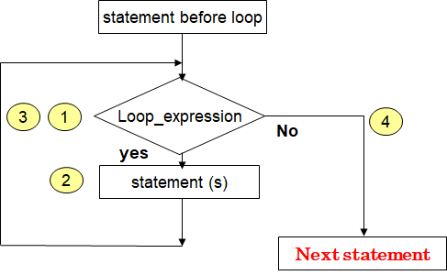
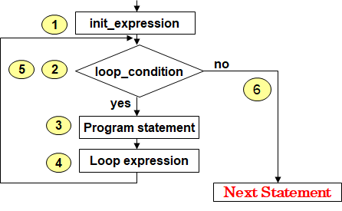
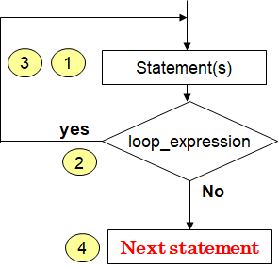
Review on decision making & looping
while ( expression )
{ program statement(s) }
for ( init_expression; loop_condition; loop_expression )
{ program statement(s) }
do { program statement (s) } while ( loop_expression );

Slide 74
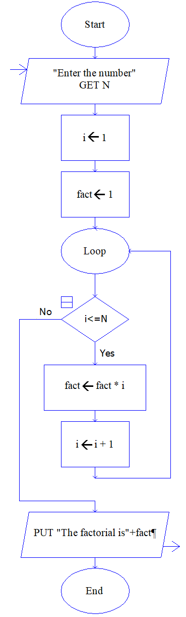
Compute the factorial of a number
Algorithm
Flowchart
Program
Name of the algorithm: Compute the factorial of a number
Step1: Start
Step 2: Input N
Step 3: fact ←1
Step 4: for i=1 to N in step of 1 do
begin
fact←fact*i
end
Step 5: Print ‘fact of N=‘, fact
Step 6: [End of algorithm]
Stop
#include <stdio.h>
int main()
{
int N, i, fact=1;
printf(“Enter the number”);
scanf(“%d”, &N);
for(i=1; i<=N; i++)
fact=fact * i;
printf(“The factorial is %d”, fact);
return 0;
}

Slide 75
Infinite loops
It’s the task of the programmer to design correctly the algorithms so that loops end at some moment !
// Program to count 1+2+3+4+5
#include <stdio.h>
int main() {
int i, n = 5, sum =0;
for ( i = 1; i <= n; n = n + 1 ) {
sum = sum + i;
printf(“%d”,sum);
}
return 0;
}
What is wrong here ?
Does the loop end?

Slide 76
Nesting of for loop
One for statement can be nested within another for statement.
for (i=0; i< m; ++i)
{ …..
….
for (j=0; j < n;++j)
{
Statement S;
} // end of inner ‘for’ statement
}// end of outer ‘for’ statement

Slide 77
Multiplication table for ‘n’ tables up to ‘k’ terms
scanf(“%d %d”,&n,&k);
for (i=1; i<=k; i++)
{
for (j=1; j<=n; j++)
{
prod = i * j;
printf(“%d * %d = %d\t”, j, i, prod);
}
printf(“\n”);
}
Enter n & k values: 3 5
The table for 3 X 5 is
1 * 1= 1 2 * 1= 2 3 * 1= 3
1 * 2= 2 2 * 2= 4 3 * 2= 6
1 * 3= 3 2 * 3= 6 3 * 3= 9
1 * 4= 4 2 * 4= 8 3 * 4= 12
1 * 5= 5 2 * 5= 10 3 * 5= 15
Notes:
3 table of 5 terms each; i.e 1s table, 2s table, 3s table ….

Slide 78
for loop variants
Multiple expressions (comma between…) for(i=0 , j=10 ; i<j ; i++ , j--)
Omitting fields (semicolon have to be still…) i=0; for( ; i<10 ; i++ )
Declaring variables for(int i=0 ; i=10 ; i++ )

Slide 79
Which loop to choose ?
Criteria: category of looping
Entry-controlled loop -> for, while
Exit-controlled loop -> do
Criteria: Number of repetitions:
Indefinite loops -> while
Counting loops -> for
You can actually rewrite any while as a for and vice versa !

Slide 80
The break Statement
Used in order to immediately exit from a loop
After a break, following statements in the loop body are skipped and execution continues with the first statement after the loop
If a break is executed from within nested loops, only the innermost loop is terminated

Slide 81
Exiting a loop with break statement
while (……….)
{…….
…………
If(condition)
break;
………
……….
} // end of while
………… //next statement
do
{…….
…………
If(condition)
break;
………
……….
} while(…);
………….. // next statement
Exit
From
loop
Exit
From
loop

Slide 82
Exiting a loop with break statement
for (……….)
{…….
for(……..)
{ ………
If(condition)
break;
… stmts of inner loop;
} // inner for loop ends
….stmts of outer loop;
} // outer for loop ends
…… next Stmts;
for
{…….
…………
If(condition)
break;
………
……….
}
……next Stmts;
Exit
From
loop
Exit
From
inner
loop

Slide 83
Check whether given number is prime or not
int j, prime=1;
scanf(“%d”,&N);
for( int j=2; j<N; j++ )
{
if( (N % j) == 0)
{
prime=0;
break; /* break out of for loop */
}
}
if (prime == 1)
printf(“%d is a prime no”,N);
else
printf(“%d is a not a prime no”,N);

Slide 84
Program to generate prime numbers between given 2 limits
scanf(“%d %d”,&m,&n);
for( int i=m; i<=n; i++) {
int prime=1;
for( int j=2; j<i; j++ ) {
if( i % j == 0)
{
prime=0;
break; /* break out of inner loop */
}
}
if (prime == 1) printf(“%d\t”,i);
}

Slide 85
Skipping a part of loop – continue statement
Skip a part of the body of the loop under certain conditions is done using continue statement.
As the name implies, continue causes the loop to be continued with next iteration, after skipping rest of the body of the loop.
while (……….) {
Statement-1;
Statement-2;
If(condition)
continue;
Statement-3;
Statement-4;
}
Next_statement
do {
Statement-1;
Statement-2;
If(condition)
continue;
Statement-3;
Statement-4;
} while(…);
Next_statement

Slide 86
Skipping a part of loop - example
for(i=10; i<=15; i++ )
{
if(i==13 || i==14)
continue;
printf(“%d\t”,i);
}
10 11 12 15

Slide 87
Skipping a part of loop
2
1
for ( i = 1 ; i <= 2 ; i++ )
{
for ( j = 1 ; j <= 2 ; j++ )
{
if ( i == j )
continue ;
printf(“\n %d\t %d\n”,i, j);
}
}
1
1 2
2 1
2 2

Slide 88
User defined Type declarations
typedef
Type definition - lets you define your own identifiers.
enum
Enumerated data type - a type with restricted set of values.

Slide 89
User defined Type Declaration
typedef type identifier;
The “type” refers to an existing data type and “identifier” refers to the new name given to the data type.
After the declaration as follows:
typedef int marks;
typedef float units;
we can use these to declare variables as shown
marks m1,m2 ; //m1 & m2are declared as integer variables
units u1, u2; //u1 & u2 are declared as floating point variables
The main advantage of typedef is that we can create meaningful data type names for increasing the readability of the program.

Slide 90
User defined Type Declaration - enum
enum identifier { value1, value2,..,value_{n} };
Here, identifier is the name of enumerated data type or tag. And value1, value2,....,valueN are values of type identifier.
By default, value1 will be equal to 0, value2 will be 1 and so on but, the programmer can change the default value.
enum card {club, diamonds, hearts, spades}; enum card {club=0, diamonds, hearts=20, spades};
enum card shape, s1;
shape = hearts;
s1 = spades;
Mainly used to assign names to integral constants, the names make a program easy to read and maintain.
Notes:
Enumeration (or enum) is a user defined data type in C. It is mainly used to assign names to integral constants, the names make a program easy to read and maintain.
Enumerated Types allow us to create our own symbolic names for a list of related ideas.
The use of an enumeration constant (enum) has many advantages over using the traditional symbolic constant style of #define. These advantages include a lower maintenance requirement, improved program readability, and better debugging capability.
Enumerated Types are a special way of creating your own Type in C. The type is a "list of key words". Enumerated types are used to make a program clearer to the reader/maintainer of the program. For example, say we want to write a program that checks for keyboard presses to find if the space bar has been pressed or not. We could say: if ( press_value == 32 ). 32 is the computers representation of the spce bar. Or, we could create our own enumerated type with the key words: space_bar. Then we could say: if ( press_value == space_bar ). This second version is much more readable and understandable to the programmer.

Slide 91
User defined Type Declaration - enum
#include<stdio.h>
int main()
{
enum year{Jan,Feb,Mar,Apr,May,Jun,Jul,Aug,Sep,Oct,Nov,Dec};
int i;
for (i=Jan; i<=Dec; i++)
printf("%d ", i);
return 0;
}
Output
Notes:
Enumeration (or enum) is a user defined data type in C. It is mainly used to assign names to integral constants, the names make a program easy to read and maintain.
Enumerated Types allow us to create our own symbolic names for a list of related ideas.
The use of an enumeration constant (enum) has many advantages over using the traditional symbolic constant style of #define. These advantages include a lower maintenance requirement, improved program readability, and better debugging capability.

Slide 92
enum week { Monday =1, Tuesday, Wednesday, Thursday, Friday, Saturday, Sunday};
printf( “ Enter n >1 & <7 “);
scanf(“%d”,&n);
switch(n) {
case Monday:
printf(“Monday”);
break;
case Tuesday:
printf(“Tuesday” );
break;
case Wednesday:
printf(“Wednesday”);
break;
case Thursday:
printf(“ Thursday“);
break;
case Friday:
printf(“ Friday”);
break;
case Saturday:
printf(“Saturday“);
break;
case Sunday:
printf(“Sunday“);
break;
default:
printf("\nInvalid Entry. Enter 1 to 7 “);
}
Notes:
Enum benefits
They restrict the values that the enum variable can take.
They force you to think about all the possible values that the enum can take.
They are a constant rather than a number, increasing readability of the program

Slide 93
Check a given number for palindrome
rev=0;
n = num;
while(num>0)
{
dig = num % 10;
rev = rev * 10 + dig;
num = num / 10;
}
if (n == rev)
printf(“\n\t GIVEN NO IS A PALINDROME“);
else
printf(“\n\t GIVEN NO NOT A PALINDROME“);
Palindrome (num)
e.g.- 121

Slide 94
Convert binary to decimal
dec = bd*2^{n} + bd*2^{n-1} + … + bd*2¹ + bd*2⁰
----------------------------------------------------------------------------------------------------
int n, p=0, sum=0, k;
printf(“Enter a binary number : “);
scanf(“%d”,&n);
do {
k=n%10; // binary number in n; extracts the digit
sum= sum + k * pow(2,p);//decimal number in sum; multiplication and summing
p++; //incrementing p value for next iteration
n= n/10; //remaining digits for next iteration
} while (n!=0);
printf(“Decimal Equivalent = %d“, sum);
e.g.- given
n=101 → 1*2² + 0*2¹ + 1*2⁰ = 5
Notes:
do {
k=n%10; // binary number in n
sum= sum + k * pow(2,p);//decimal number in sum
p++;
n= n/10;
} while (n!=0);

Slide 95
Sine series for a given ‘n’ terms & angle ‘x’
# define PI 3.141592
Sine series
sin(x)= x - x³/3! + x⁵/5! - … x^{n}/n!
scanf("%d %f",&n,&x);
no=x;
x=x*PI/180.0; // degrees to radians conversion
term=x; // first term value
sum=x; //term stored in sum
for (i=1;i<=n;i++) // computation & summation for second term onwards
{
term= term*(((-1)*x*x)/(2*i*(2*i+1)));
sum+=term;
}
printf("Library value of Sin(%.2f) = %.2f ", no, sin(x));
printf("\nSin (%.2f) = %.2f", no, sum);
Notes:
term=x;
sum=x;
for (i=1;i<=n;i++) {
term=(term*pow((-1),(2*i-1))*x*x)/(2*i*(2*i+1));
sum+=term;
}
*****************************************************************************8
#define in C is a directive which is used to #define alias.
typedef: The typedef is used to give data type a new name.
Difference between typedef and #define:
typedef is limited to giving symbolic names to types only, whereas #define can be used to define an alias for values as well, e.g., you can define 1 as ONE, 3.14 as PI, etc.
typedef interpretation is performed by the compiler where #define statements are performed by preprocessor.
#define should not be terminated with a semicolon, but typedef should be terminated with semicolon.
#define will just copy-paste the definition values at the point of use, while typedef is the actual definition of a new type.
typedef follows the scope rule which means if a new type is defined in a scope (inside a function), then the new type name will only be visible till the scope is there. In case of #define, when preprocessor encounters #define, it replaces all the occurrences, after that (No scope rule is followed).

Slide 96
Armstrong nos for a given limit ‘n’
scanf(“%d”,&lim);
for(n=1;n<lim;n++){
sum = 0;
num = n;
while(num>0) {
dig = num%10;
sum = sum+pow(dig,3);
num = num/10;
}
if(sum == n)
printf(“%d\n\t”,n);
}
Armstrong Number
e.g. - 371
∑ (cubes of digits )= num
3³ + 7³ + 1³ = 371

Slide 97
Count the even and odd digits in a given ‘n’ digit number
scanf(“%d”,&num);
while(num > 0)
{
rem=num%10;
num =num/10;
if(rem%2==0)
ecnt++;
else
ocnt++;
}
printf(“%d even & %d odd digits”, ecnt, ocnt);
e.g.- num = 31467
OUTPUT
2 even & 3 odd digits

Slide 98
Tutorial Problems
Write a C program to count number of digits in any number
Write a C program to find last and first digit of any number
Write a C program to enter any number and print all its factors
Write a C program to find LCM of two numbers
Write a C program to convert Binary to Octal number
Write a C program to print all natural numbers from n-0 in reverse using while loop

Slide 99
Summary
The for Statement
Nested for Loops
for Loop Variants
The while Statement
The do Statement
The break Statement
The continue Statement
Typedef and Enum

Slide 100
Error or not !…
int x=3;
if (x=2)
x=0;
if (x==3)
x+=1;
else
x+=2;
printf(“%d”, x);
Warning!
Possibly incorrect assignment
Output:
2

Slide 101
Error or not !…
int x=3, y=15;
if (x = y%2)
x=0;
else
x+=2;
printf(“%d”, x);
if (x = y%3)
Warning!
Possibly incorrect assignment
Output:
0
Output:
2
Why output =0?
x=1; Condition is always TRUE for values other than 0!
Why output = 2?
x=0; Condition is always WRONG for a value 0!

Slide 102
Error or not !…
int i, n=10;
for (i=0; i<n; i++)
i+=i;
printf(“%d”, i);
for (i=0; i<n; i++);
No Error!
No Error!
Output:
15
Output:
20

